Slide 1

SMART HOME ADVISOR
01

Slide 2


IN THIS PRESENTATION:
01
Project Overview.
We will explain the tools and elements we used, the problems we faced, and how to solve them.
02
03
Project running.
02

Slide 3

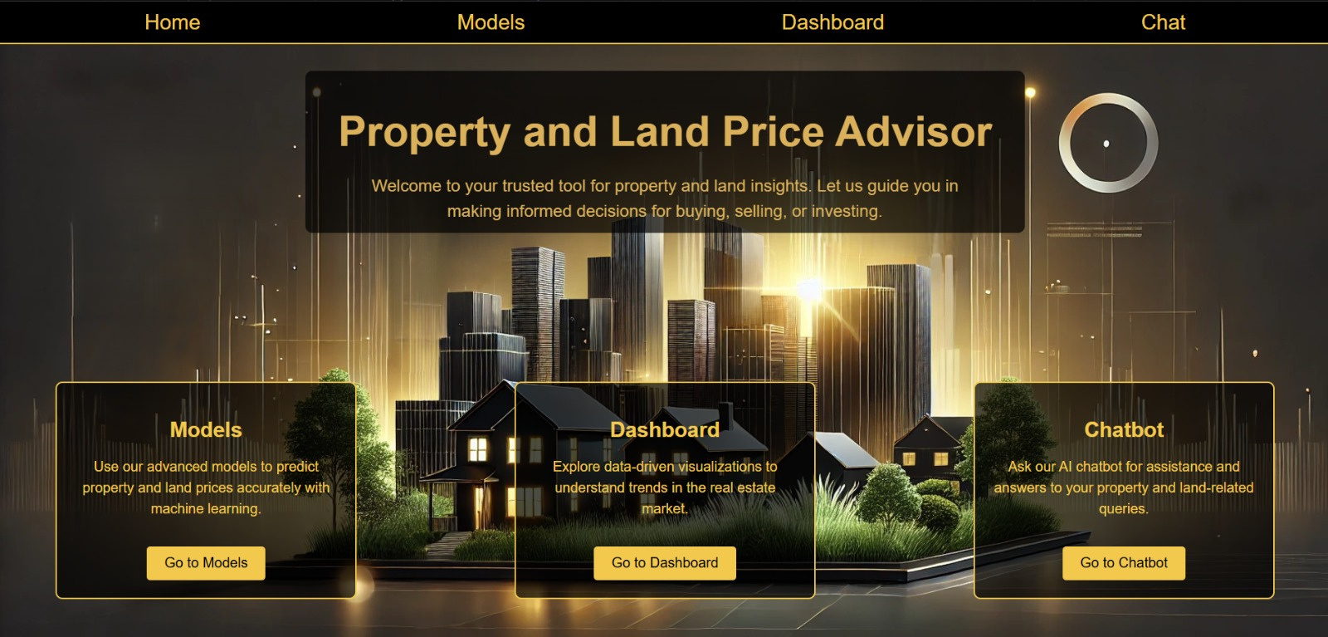
01
Project Overview - Home Page
03

Slide 4
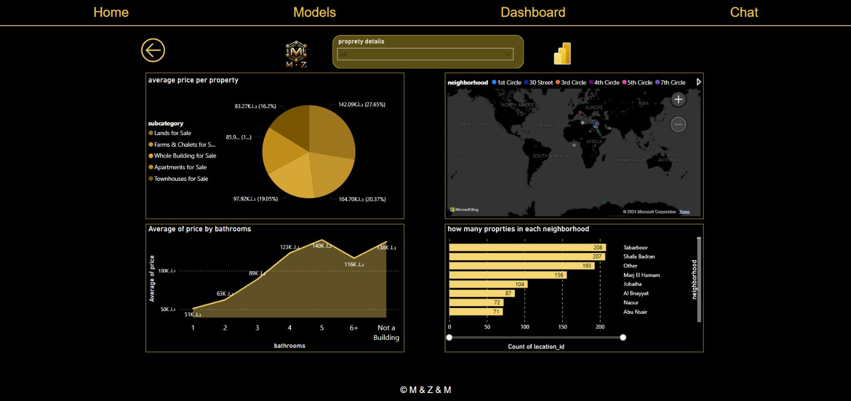
Project Overview - Dashboard Page
04

Slide 5
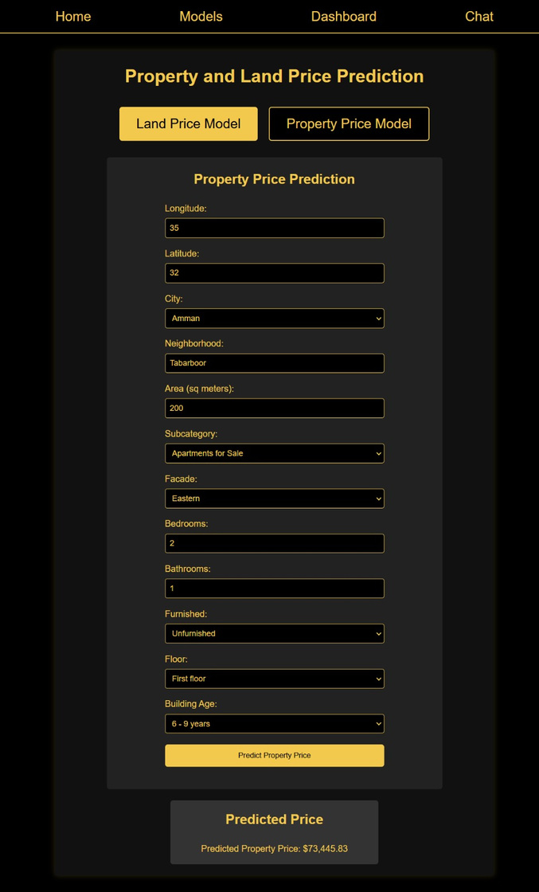
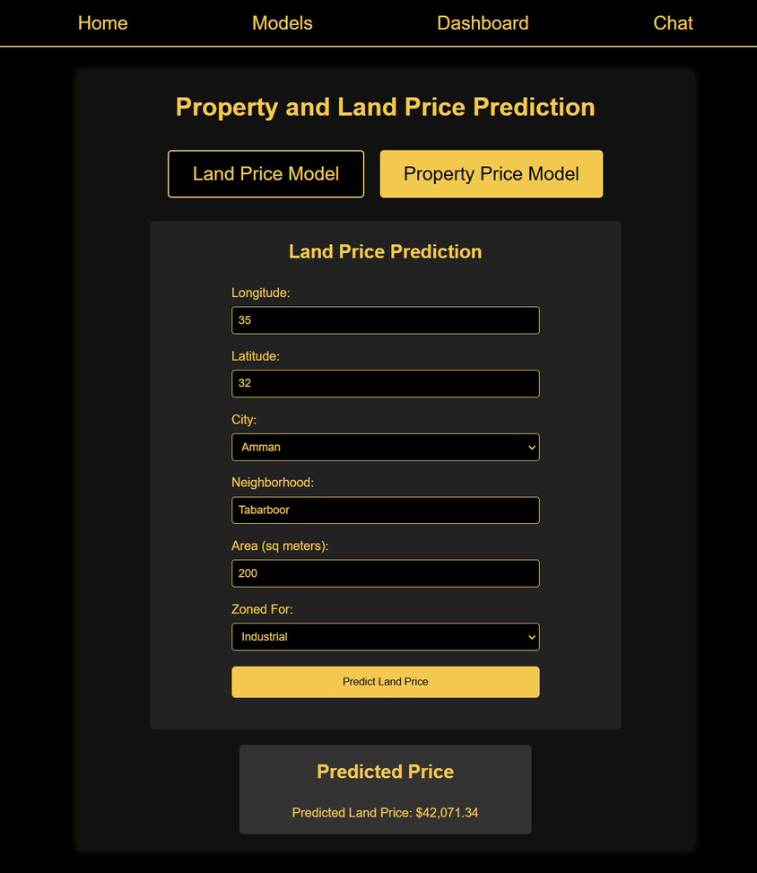
Project Overview - Models Page
05

Slide 6

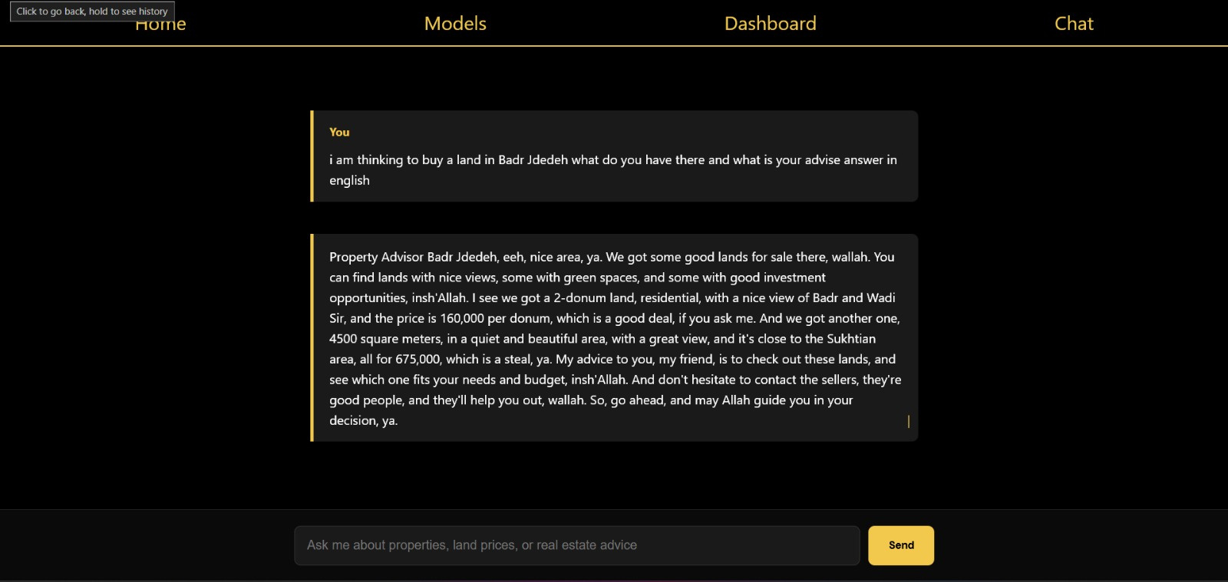
Project Overview - Chatbot Page
06

Slide 7

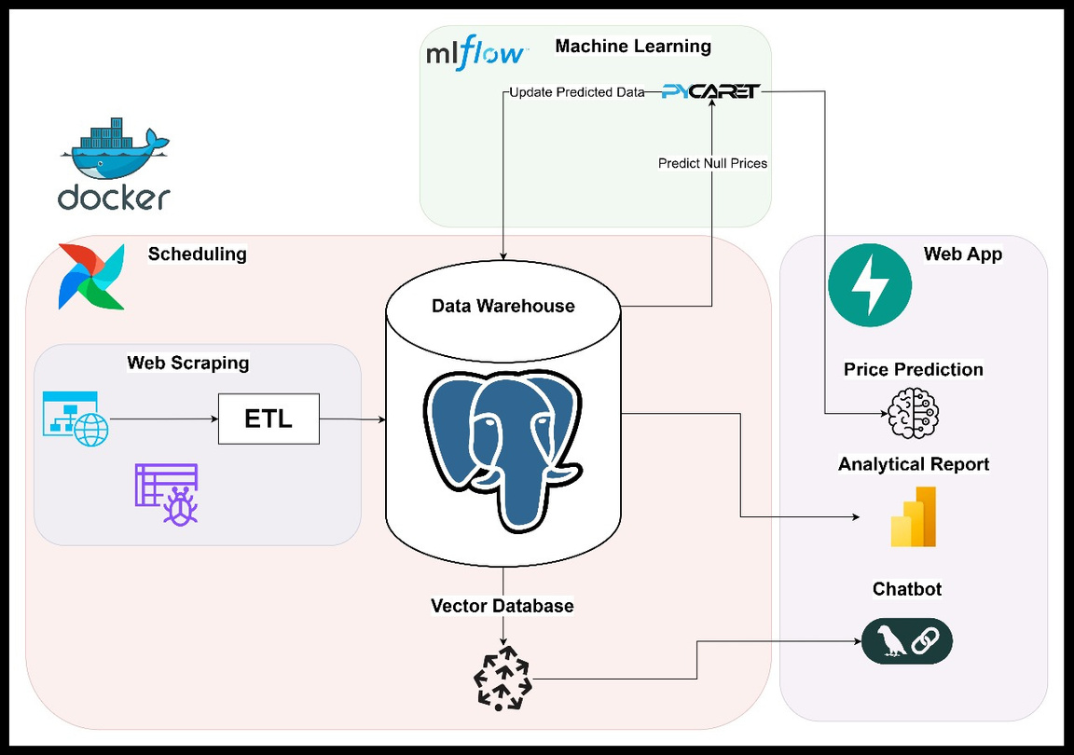
02
Technical Implementation
Our project is divided into three main technical components:
Web Scraping, Building a Data Warehouse (DW), and ETL.
Building a Machine Learning Model.
Building a Chatbot and Web Application.
each focusing on a critical aspect of development and functionality. The following diagram provides an overview of the entire workflow and the tools used in each stage.
07

Slide 8



Web Scraping, Building a Data Warehouse (DW), and ETL:
Our project starts with good planning, and since we will need data, it was necessary to build a data warehouse for this project's analytical needs.
We used PostgreSQL to build the warehouse, although it’s not the right option to build professional data warehouses on an enterprise level, it satisfies the needs of this project by being beginner-friendly, free, and with wide support and documentation across the internet.
08

Slide 9

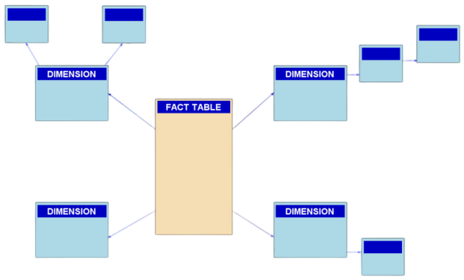
Now building the schema for a warehouse is not the same as for a relational database, so we used a star(snowflake) schema for it.
Throughout working on this project, we started to notice that we didn’t want a lot of the columns from all the data, that’s why we shrank the warehouse by a huge margin from the beginning of this project.
09

Slide 10
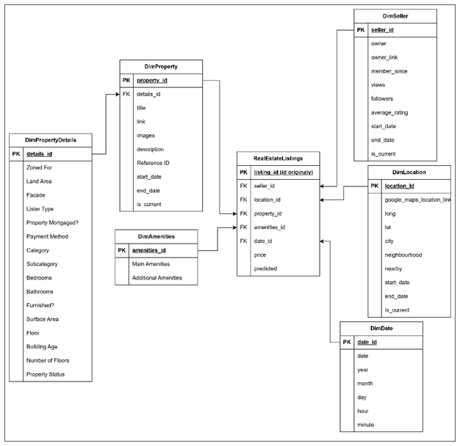
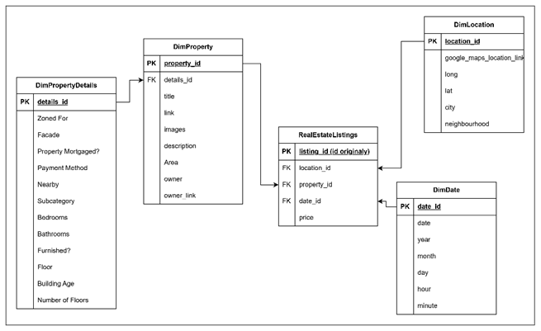
Old Warehouse
New Warehouse
10

Slide 11
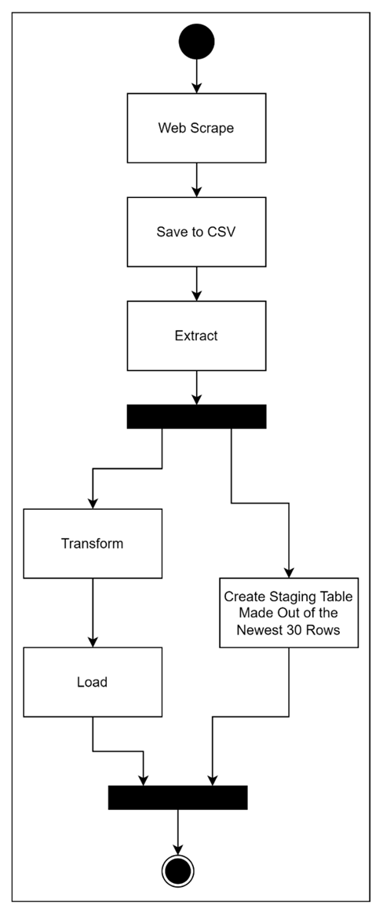
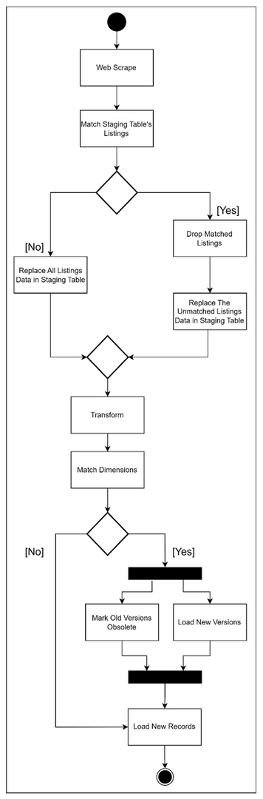

initial Pipeline
incremental Pipeline
Now that the warehouse is ready, we shall start by building the data pipelines, we started by building an initial data pipeline that will run once and only once to extract everything from the website, and another incremental data pipeline that will work daily to extract data.
These pipelines are mostly similar but with a few minor changes that we will be explaining later.
11

Slide 12

To start the pipeline, we will need to extract the data using web scraping.
Web scraping is pulling data from the web using bots or scripts, for our pipeline we used bs4 to extract the data. We used bs4 because It’s lightweight and fits the needs of our project with no extra unnecessary features.
The web scraping script starts by pulling listings from the real estate tab from opensooq.com, the initial pipeline will pull everything out there but for our incremental pipeline, it will only pull the newest 1000 listings.
12

Slide 13
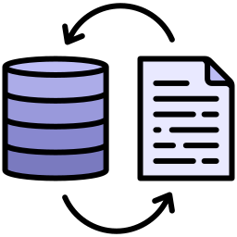
After these listings are pulled along with their links, we will start extracting the features of each listing.
After scraping is done we will save the listings into a CSV file, to use in later steps.
The second phase of the data pipeline would be the transformation, we will be cleaning the data we extracted to make it suitable for storing in the data warehouse and ready for the next parts of the project.
13

Slide 14

When we talk about normalizing the database/data warehouse here we are not talking about machine learning normalization. We are talking about removing duplicates and resetting the index to avoid primary key duplication errors.
After the transformation is done, we will store the data in the data warehouse so that it can be used in the other parts of the project.
15

Slide 15

2. Building a Machine Learning Model & project management:
After completing the first phase and preparing the data for use, we started building a machine-learning model to predict property prices based on various features, such as type, location, coordinates, area, and city.
To develop this model, we utilized PyCaret, an automated machine learning framework that constructs numerous data pipelines and identifies the model with the highest efficiency.
16

Slide 16

Initially, however, we observed that the model's performance was quite poor. The main reason for this was the diversity of properties in our dataset. The data included a mix of houses, buildings, commercial shops, and lands, with features for lands differing significantly from those of other property types.
To address this issue, we decided to build two separate machine learning models instead of one:
The first model specializes in predicting land prices.
The second model focuses on other property types.
This approach allowed us to improve the accuracy and relevance of our predictions for each category.
17

Slide 17
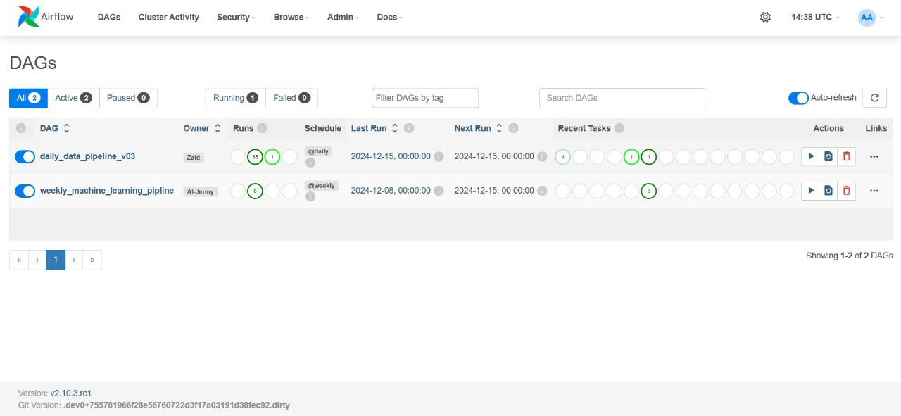
To manage the project and monitor all results effectively, we utilized Airflow, a powerful workflow orchestration tool. Airflow allows us to automate and schedule complex workflows by defining them as Directed Acyclic Graphs (DAGs).
18

Slide 18
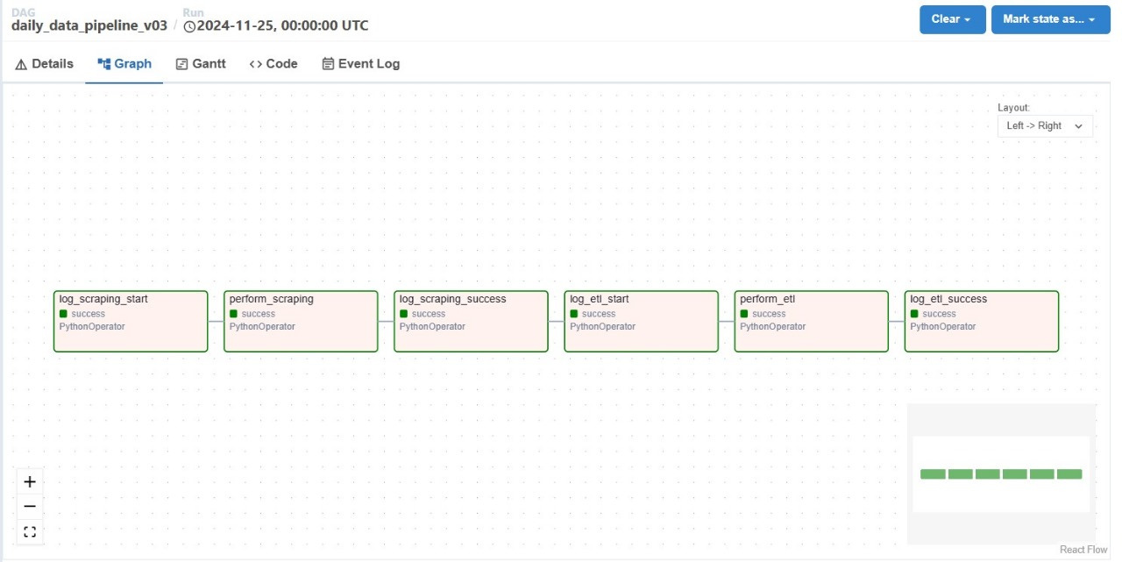
Data Pipeline Management:
We created a workflow that ensures data is extracted and stored in our data warehouse daily without interruptions.
19

Slide 19
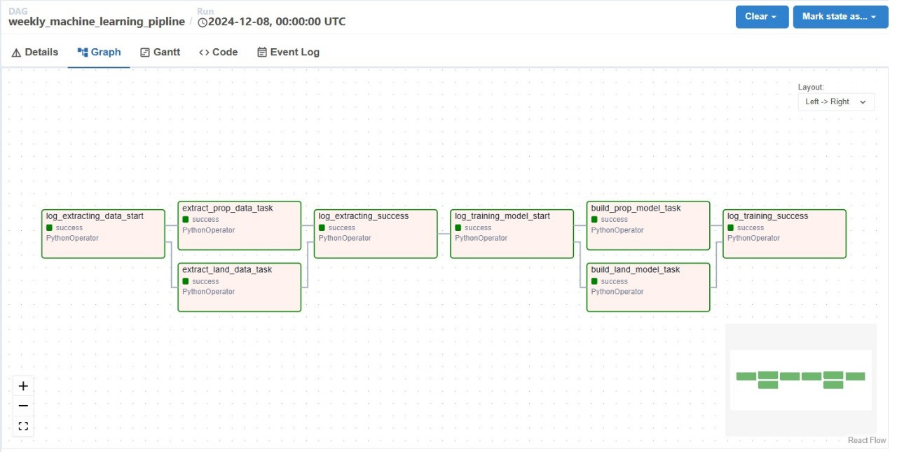
Machine Learning Model Management:
Another workflow handles the weekly training and storage of both machine learning models, ensuring the process runs smoothly and without errors.
20

Slide 20

Working with Airflow is not easy due to the numerous challenges it can present. In fact, there are entire companies dedicated to installing and troubleshooting Airflow for other organizations. Therefore, it was natural for us to face some issues, especially since this was our first experience using it.
challenges
21

Slide 21
Challenges We Faced
Installing Airflow:
We encountered difficulties during the installation process. Airflow requires several tools, such as WSL, as it primarily operates on Linux systems. Additionally, we needed Docker to simplify the installation and setup process.
Installation
22

Slide 22
2. Library Compatibility:
Airflow initially failed to recognize the libraries used in our project, such as MLflow, PyCaret, SQLAlchemy, and others. This issue arose because Airflow runs inside a container that only includes the basic components required for its operation. To resolve this, we wrote a Dockerfile to install all the necessary libraries inside the container.
Compatibility
23

Slide 23
3. PyCaret Compatibility with Python:
Another issue was that PyCaret did not support the latest Python version used by Airflow by default. To address this, we modified the Python version used by Airflow by installing a Docker Image with a version compatible with PyCaret.
Python version
24

Slide 24
4. Model and Training File Storage:
We faced a challenge with storing machine learning models and training files. By default, these files are stored inside the Airflow container, which can lead to data loss when the container is restarted. To fix this, we adjusted the storage path to ensure the files are saved in a persistent external location.
Storage
25

Slide 25

Additionally, we used MLflow to track and store the results of our model training processes. MLflow provides a comprehensive platform for:
Tracking: Monitoring various training runs and recording metrics, parameters, and model performance.
Comparison: Comparing results across different training sessions to select the best-performing model for deployment.
Storage: Managing and storing trained models for future use.
By integrating Airflow and MLflow, we ensured seamless automation, efficient tracking, and consistent improvement in our machine learning workflows.
26

Slide 26
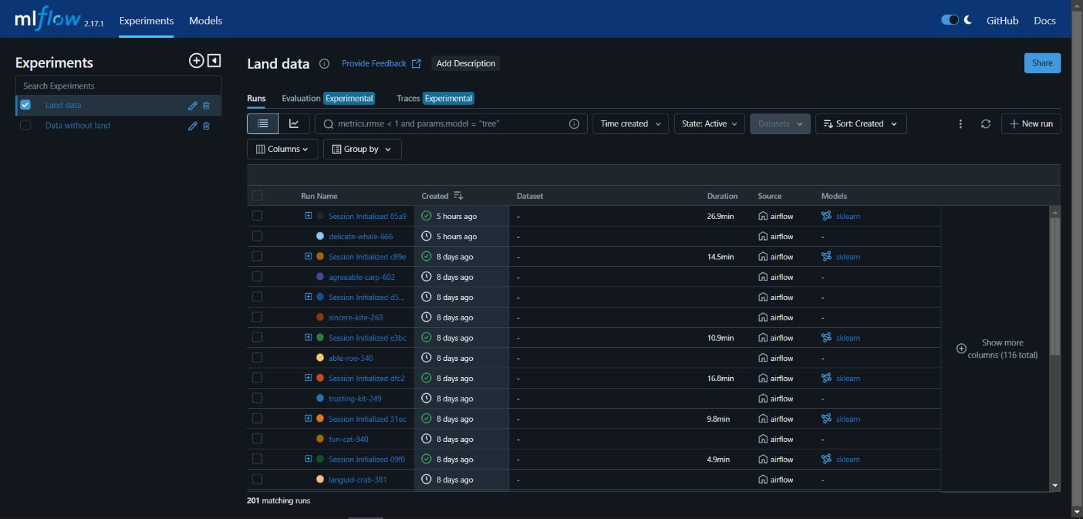
27

Slide 27
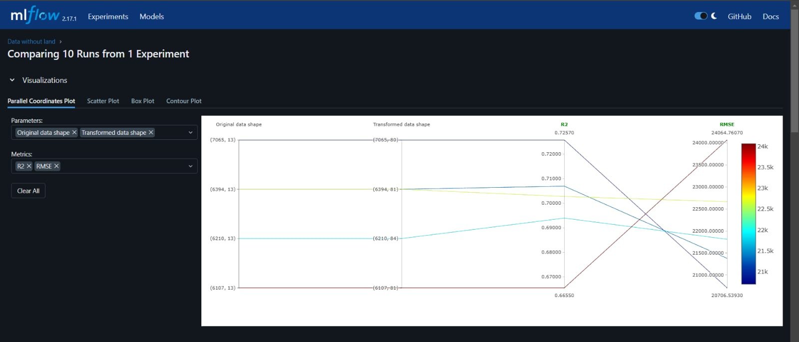
28

Slide 28

3. Building a Dashboard, Chatbot & Web Application.
This dashboard is designed to mimic the look and functionality of an application, ensuring a user-friendly and interactive experience.
The dashboard contains 3 pages as follows:
page-1: main menu
page-2: Info Page
page-3: Location and Property Analysis
29

Slide 29
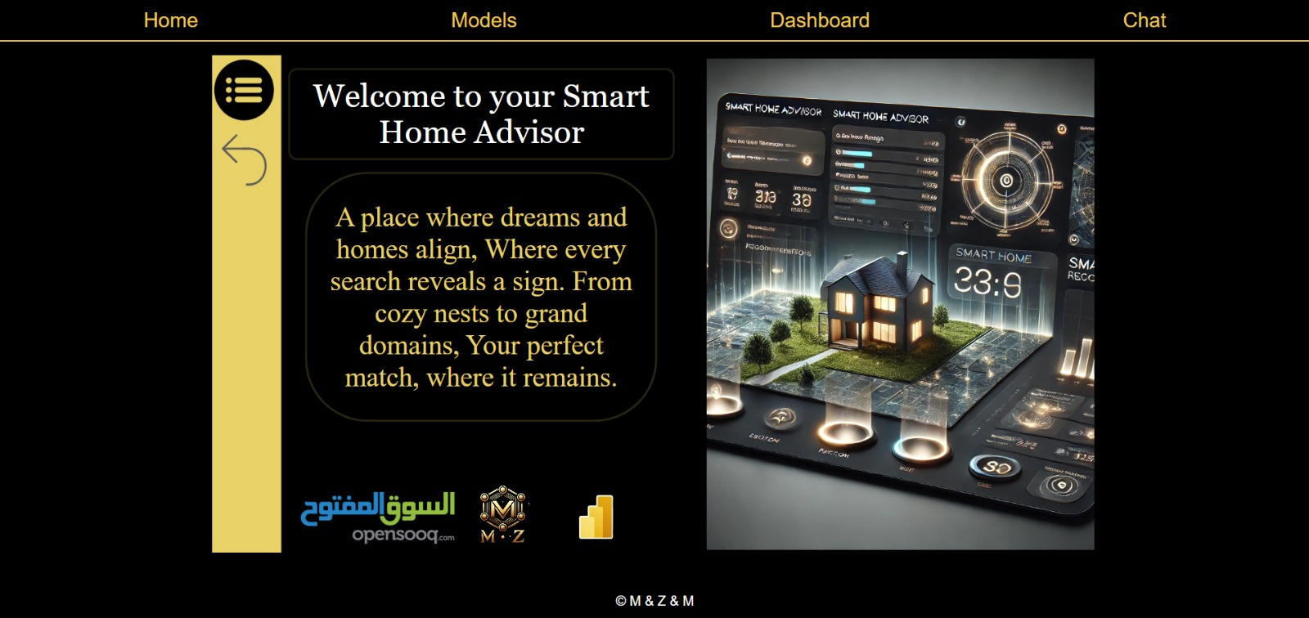
main menu - Page 1:
The first page serves as the main menu, built using bookmarks and selection tabs for seamless navigation between pages.
30

Slide 30
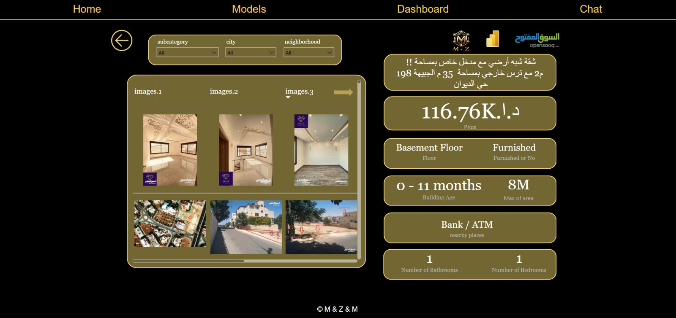
Info Page - Page 2
This page allows users to filter properties using slicers for property type, city, and neighborhood.
A dynamically updated table displays property details, including images (if available), formatted to align in a good shape within the table rows.
cards to show the property details for the user to get a comprahinsive look .
31

Slide 31
Location and Property Analysis - Page 3
an interactive map of Jordan showcasing neighborhoods and cities.
Includes a pie chart to display price distributions for the most in-demand properties.
A bar chart reveals which neighborhoods have the highest number of property ads.
A slicer with a filed parameter function provides a smart and efficient way to analyze property prices in detail, supported by a line chart for deeper insights.
32

Slide 32



We developed a specialized chatbot designed to deliver accurate and prompt responses using advanced technologies. The core model was built with Groq and LLaMA 3.1-70B model, where Groq ensures high-performance execution, and Llama provides robust language capabilities.
33

Slide 33

For data management and retrieval, we utilized FAISS Vector DB to store and efficiently retrieve relevant paragraphs, along with SentenceTransformer to encode texts into high-quality numerical representations.
The required data for training and feeding the system was extracted directly from the data warehouses we had previously built, enabling seamless integration between different components of the project.
FAISS
34

Slide 34



For building API we used FastAPI because it offers high performance, simplicity, and automatic API documentation, making it an ideal choice for learning modern API development and asynchronous programming.
Key Features of FastAPI
Routing with Decorators:
FastAPI uses Python function decorators (e.g., @app.get, @app.post) to define API routes.
Each path operation corresponds to an endpoint that handles specific HTTP methods like GET, POST, PUT, or DELETE.
Request Handling:
FastAPI handles incoming HTTP requests and maps them to specific Python functions based on the route and method.
Asynchronous Programming:
FastAPI leverages Python's async and await syntax for non-blocking I/O operations, making it efficient for handling multiple requests concurrently.
35

Slide 35
Challenges Encountered
Model Loading:
Loading the models was a bit tricky.
I had to ensure that the user inputs matched the expected format for each feature.
Case sensitivity issues occurred, where user input differed in capitalization. To address this, I provided a list of valid, trained-on feature names to ensure accurate predictions.
Challengs
36

Slide 36
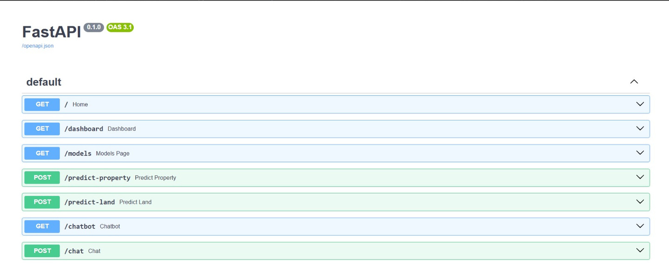
connecting the dash, chatbot, and models to the webpage:
built the webpages using HTML, CSS, and JavaScript and declared the wanted features and their limitations.
those are done using the get decorator to get the front-end design and the post decorator to send the response that's wanted.
37

Slide 37
connected the Power BI dashboard using its token from the Power BI service and used it in HTML + fast API to get it done.
38

Slide 38
Do you have
any questions?

Slide 39


Thank you

